Slide 1
Classifying Music Data
Becky Crawford
University of Houston Downtown – MS Data Analytics—Spring 2019

Slide 2

Presentation Outline
Introduction of Topic
Approach and tools used
Data Source
Data Cleaning
Analysis Performed
Results
Conclusion

Slide 3



Project Motivation
Music is a part of everyday life
Suggested and curated music works incredibly well
Interested in understanding the basic mechanics of algorithmic music platforms

Slide 4
Research Topic
Exploring different analytical techniques to classify music data into its genre
Hypothesis: feature-based, traditional machine learning algorithms will perform better than deep learning methods applied directly to the .mp3 data

Slide 5
Technologies Used
R & R Studio
Microsoft Excel
Python
Jupyter Notebooks
High Performance Computing Cluster (Unix environment)

Slide 6


Data Source
Free Music Archive (FMA)
Github.com/fma
Tabular Data Sources
LibROSA
15 Parent Genres (classes)
13k rows
241 columns
16 Parent Genres (classes)
100k rows
518 columns

Slide 7
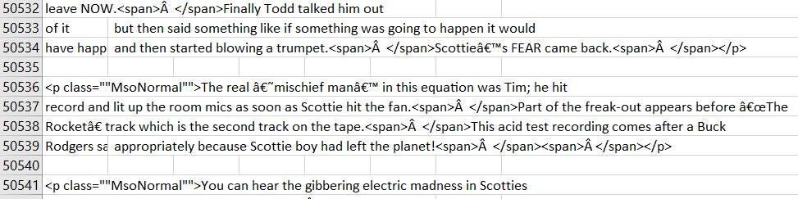
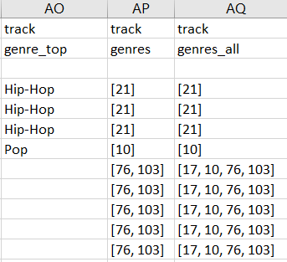
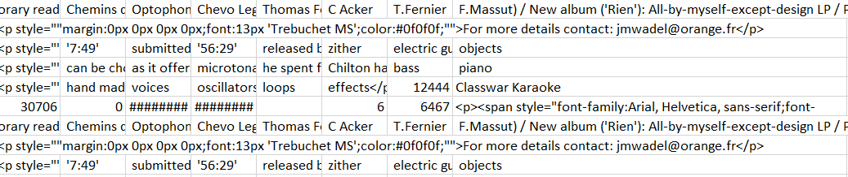
Data Cleaning
Tracks file – class labels and track id
Format issues – foreign characters, symbols and missing rows
Parent and child genres - many to many relationship

Slide 8
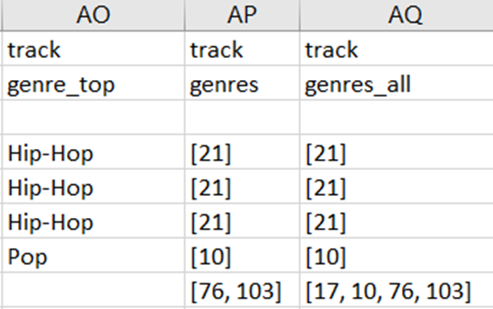
[17, 10, 76, 103]
17, 10, 76, 103
Parent Genre ID | Genre Title
38 | Experimental
2 | International
3 | Blues
4 | Jazz
5 | Classical
20 | Spoken
8 | Old-Time / Historic
9 | Country
10 | Pop
14 | Soul-RnB
12 | Rock
13 | Easy Listening
15 | Electronic
17 | Folk
1235 | Instrumental
21 | Hip-Hop
| 17 | 10 | 76 | 103 |
17

Slide 9
Tabular Data Analysis Technique
Narrow down the amount of features in the datasets
Address class imbalance
Apply machine learning algorithms
Evaluate model performance

Slide 10
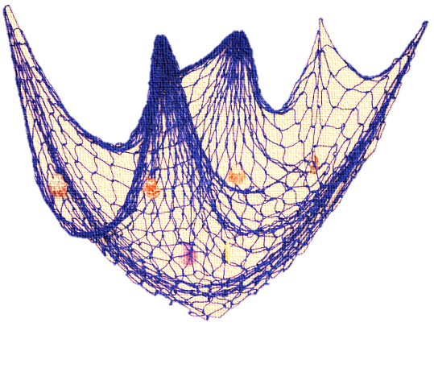
Feature Selection – Logistic Regression
Goal: reduce the number of variables to less than 100 while still maintaining representation of each observation
R package used – glmnet
Approach used: 10-fold cross-validated elastic net logistic regression on the entire dataset
Extract the model coefficients and keep only the most significant features
Result: 85% reduction in features while still keeping > 60% variance explained

Slide 11

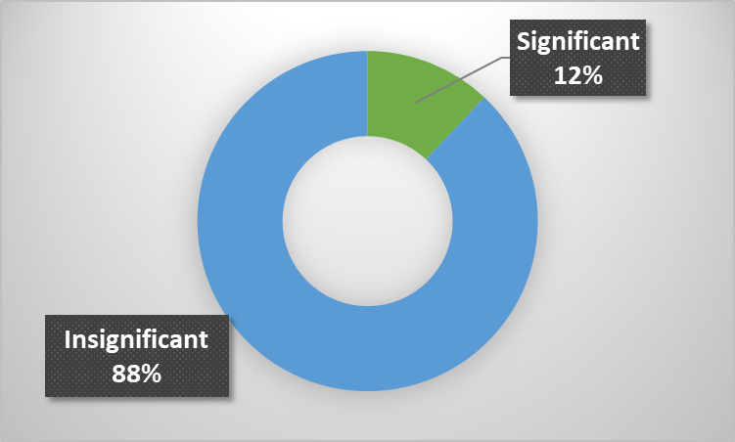
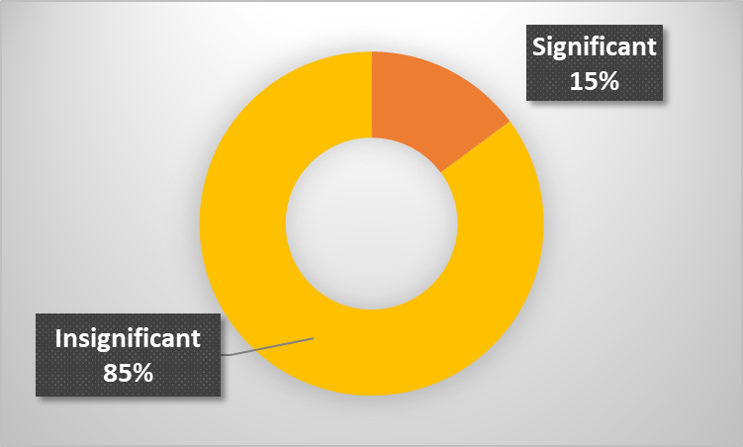
Feature Selection Results
241 columns → 29 columns
518 columns → 77 columns

Slide 12
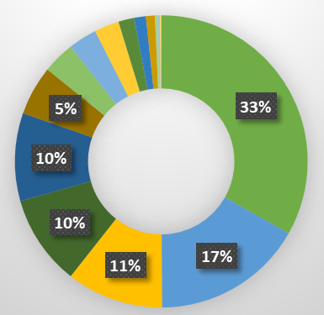
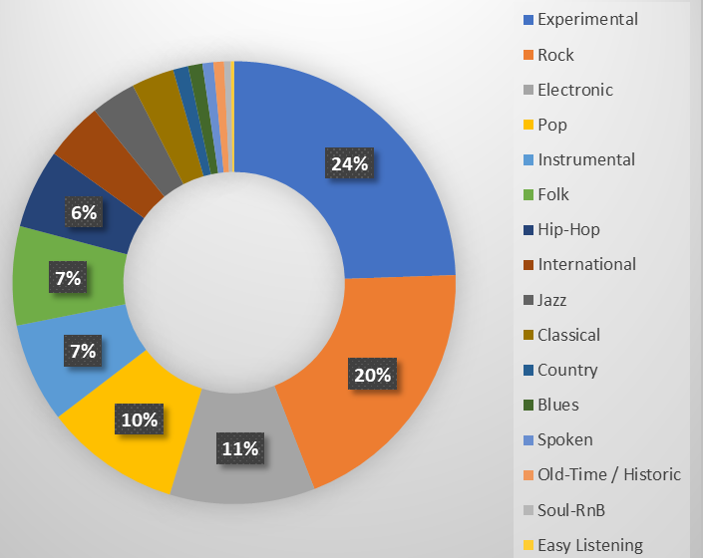
Class Imbalance
80/20 split into training and test sets

Slide 13
Addressing Class Imbalance
Problem: predictive models will simply ignore minority classes
Solution: generate synthetic data points in the minority classes to have a more even representation of every genre
Method: SMOTE
Synthetic minority over-sampling technique with replacement
In R, the DMwR package is used
Executed for each minority class against the majority class
Result: an essentially balanced dataset

Slide 14

Predictive Approach: Random Forest
Random forest builds an ensemble of decision trees, then merges them together to get a more accurate and stable prediction
Works well on numeric data with the target variable being categorical
Used the kernlab package in R
Source: medium.com/@williamkoehrsen/random-forest-simple-explanation
Notes:
Source: https://towardsdatascience.com/the-random-forest-algorithm-d457d499ffcd

Slide 15
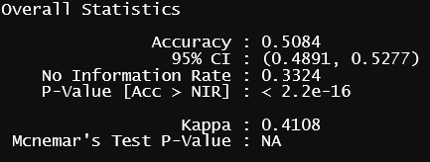
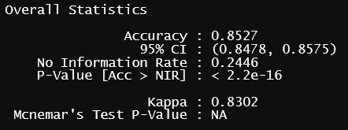
Random Forest Results
Class Level Sensitivity: 0 – 74%
Class Level Specificity: 85 – 100%
Class Level Sensitivity: 79 – 92%
Class Level Specificity: 93 – 99%
Notes:
Kappa represent class imbalance, small is a bad thing and means prediction is simply by chance. Also refer to sensitivity and specificity for this ino.

Slide 16
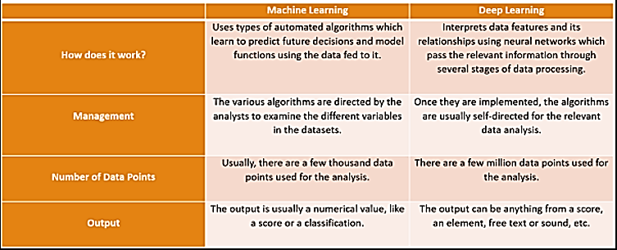
What’s the Difference?
Source: http://www.iamwire.com/2017/11/difference-between-machine-learning-and-deep-learning/169100

Slide 17
Deep Learning Approach
Use the 30 second sample .mp3 files
About 5k samples used
Convert .mp3 samples to images (spectrograms)
LibROSA package used
Use images as matrices to feed a convolutional neural network (CNN)
Create a binary classification problem by labelling majority class and other

Slide 18
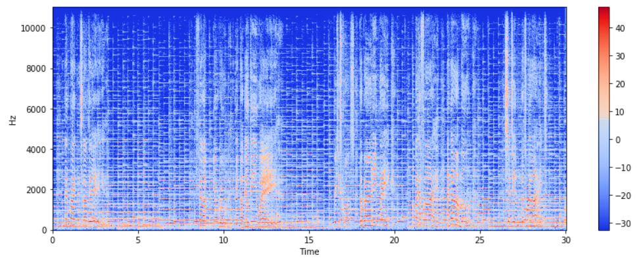
Spectrograms: Full Size
1025, 1200 pixels

Slide 19
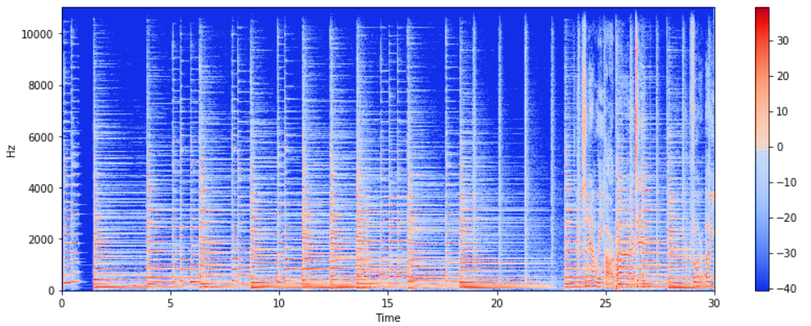
Spectrograms: Resized 20%
205, 240 pixels

Slide 20
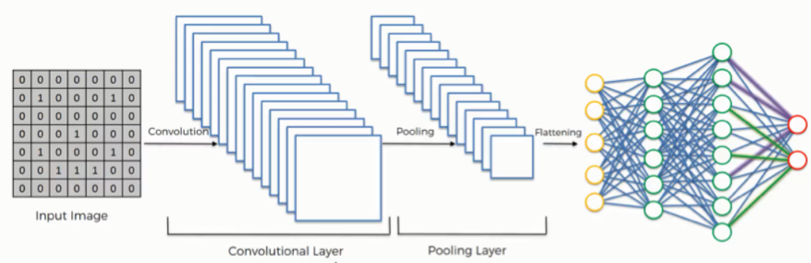
Analytic Approach: CNN
Used keras package in python
Ran on a high performance computing cluster
Source: https://www.superdatascience.com/blogs/the-ultimate-guide-to-convolutional-neural-networks-cnn
Notes:
Source: https://www.superdatascience.com/blogs/the-ultimate-guide-to-convolutional-neural-networks-cnn

Slide 21
CNN Results
_________________________________________________________________
Layer (type) Output Shape Param #
=================================================================
conv2d_4 (Conv2D) (None, 205, 240, 100) 10100
_________________________________________________________________
activation_9 (Activation) (None, 205, 240, 100) 0
_________________________________________________________________
max_pooling2d_4 (MaxPooling2 (None, 102, 120, 100) 0
_________________________________________________________________
batch_normalization_7 (Batch (None, 102, 120, 100) 400
_________________________________________________________________
dropout_5 (Dropout) (None, 102, 120, 100) 0
_________________________________________________________________
conv2d_5 (Conv2D) (None, 102, 120, 60) 150060
_________________________________________________________________
activation_10 (Activation) (None, 102, 120, 60) 0
_________________________________________________________________
max_pooling2d_5 (MaxPooling2 (None, 51, 60, 60) 0
_________________________________________________________________
batch_normalization_8 (Batch (None, 51, 60, 60) 240
_________________________________________________________________
dropout_6 (Dropout) (None, 51, 60, 60) 0
_________________________________________________________________
conv2d_6 (Conv2D) (None, 51, 60, 45) 270045
_________________________________________________________________
activation_11 (Activation) (None, 51, 60, 45) 0
_________________________________________________________________
max_pooling2d_6 (MaxPooling2 (None, 25, 30, 45) 0
_________________________________________________________________
batch_normalization_9 (Batch (None, 25, 30, 45) 180
_________________________________________________________________
dropout_7 (Dropout) (None, 25, 30, 45) 0
Testing Accuracy:
accuracy: 67.8%
Kappa: 0.008
roc_auc_score 0.504
Testing Confusion Matrix |  | Actual Values
Predicted Values |  | Majority Class | Other
 | Majority Class | 999 | 177
 | Other | 326 | 61
Notes:
Null model is 55% majority class. ROC AUC plots true positive and false positive rates. 50% IS BAD 1 IS PERFECT. Small Kappa suggest that the classification is by chance. I used the adam optimizer and the ReLU activation function.

Slide 22
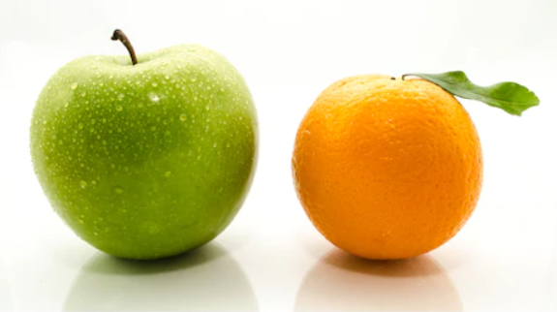

Slide 23
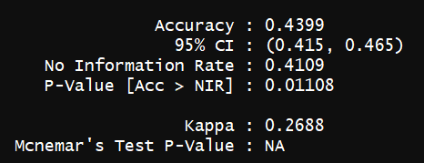
Re-Doing the Random Forest
The CNN did a better job at classifying on a limited sample

Slide 24


And the Winner is…
 | Random Forest on LibROSA | Convolutional Neural Network on mp3 Files
Overall Accuracy
Kappa Value
Data Cleaning Required
Ability to Scale/Computing Resource Required
Ability to easily address class imbalance
CNN wins on accuracy : my hypothesis is incorrect
Random Forest wins on real-world application where time and money need consideration

Slide 25
Future Work
Try LSTM deep learning models to explore correlation in the audio signal
Generate a more balanced .mp3 training and test set and try to expand from binary classification with CNN
Try ensemble methods utilizing the categorical metadata that was discarded from the class label file

Slide 26
Thank You
Professor Sponsor: Dr. Soibam
Advisor: Dr. DeLaVina
Deans & Administrators

Slide 27
Questions?

